Slide 1
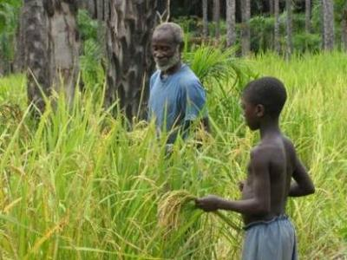
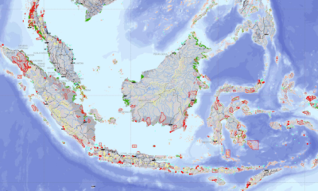
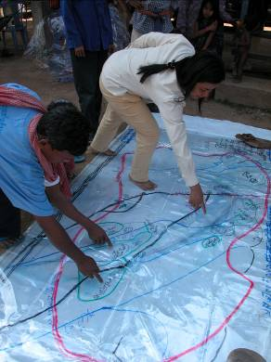




UNDP/GEF SGP
and the
Indigenous and Community Conserved Areas (ICCAs) Registry
GBF/TILCEPA
Terence Hay-Edie
UNDP/GEF Small Grants Programme (SGP)
GBF/TILCEPA

Slide 2
SGP background
Total GEF investment in SGP since 1992 pilot phase over $600 million
SGP provides direct access for national NGOs and CBOs, and indigenous peoples up to $50,000
Projects approved by a National Steering Committee with a non-governmental majority (incl. indigenous reps)
Over 14,500 projects funded since 1992 in 123 countries
Implemented by UNDP on behalf of the GEF partnership of agencies

Slide 3
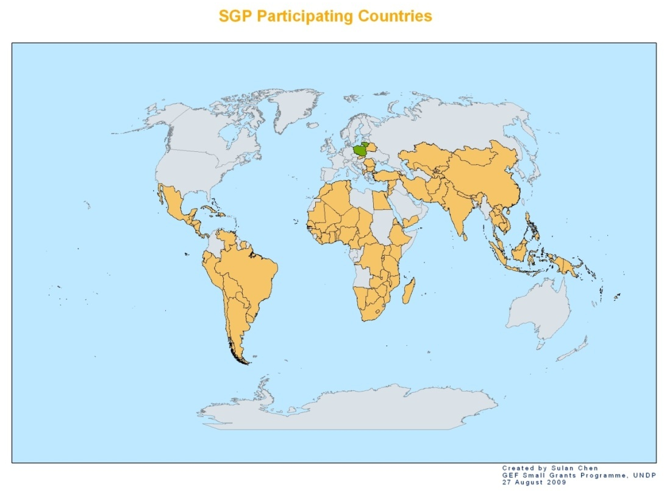
SGP Coverage: Rapid growth from 65 to 123 countries over the last 5 years

Slide 4
SGP Project portfolio by GEF focal area

Slide 5
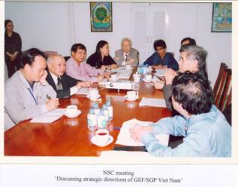
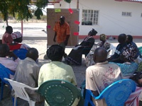
SGP as a ready and effective programming and delivery mechanism
SGP voluntary National Steering Committee (NSC) operational country level mechanisms established and ready
Active and capable network of community level grassroots constituencies
Ready “infrastructure” for rolling out a global programme for funding community intervention
Above characteristics ensure effective delivery of funding DIRECTLY to poor communities even in remote areas.

Slide 6
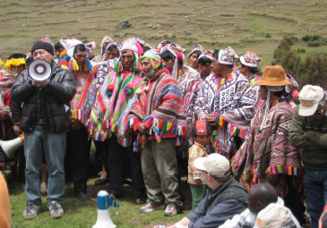
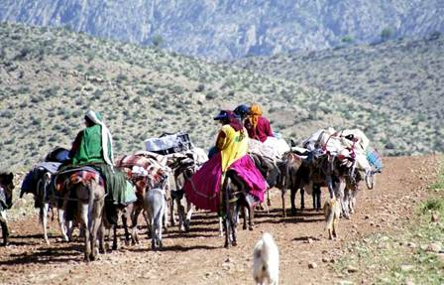
SGP portfolio support to indigenous peoples
Direct support to indigenous peoples approx 15% of SGP portfolio out of 14,500 small grants
Also approx 17% of SGP projects with women’s organisations
Participatory video & other innovative formats for increased access for remote populations

Slide 7
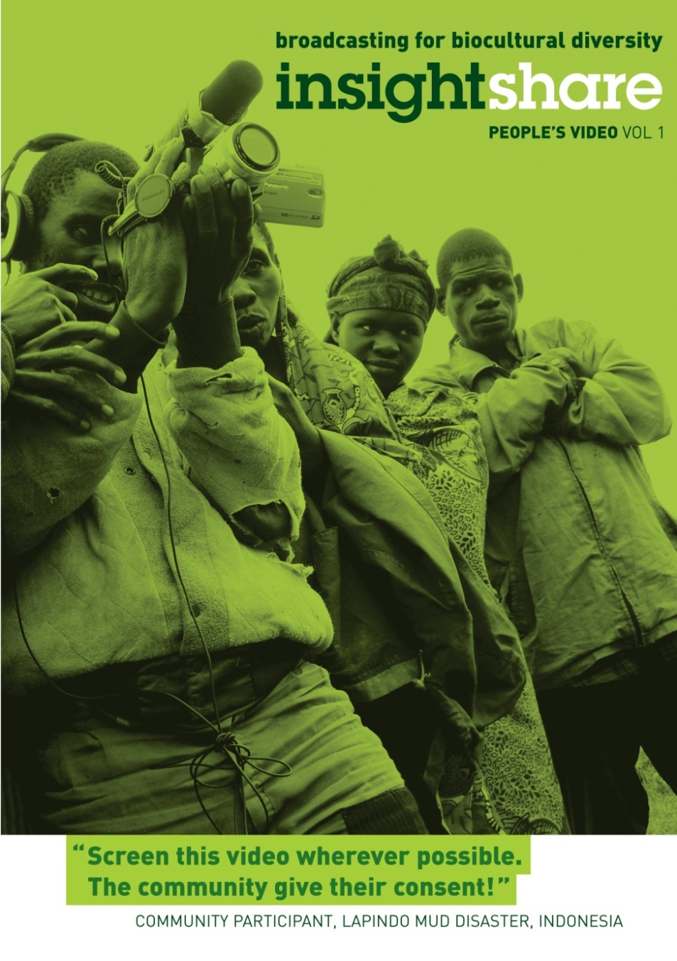
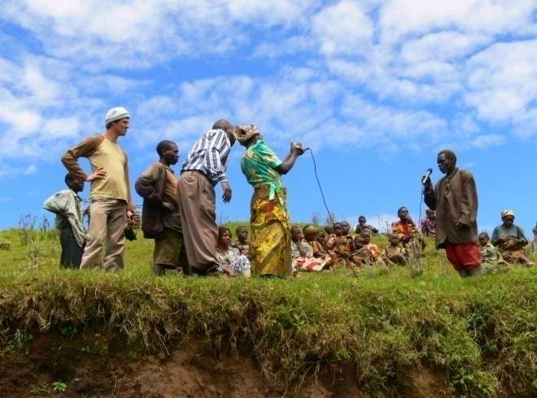
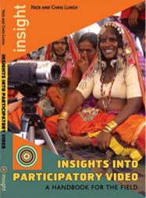
SGP approaches: Participatory Video
Need for alternative proposal formats and tools
Allow for expression in local and vernacular languages

Slide 8
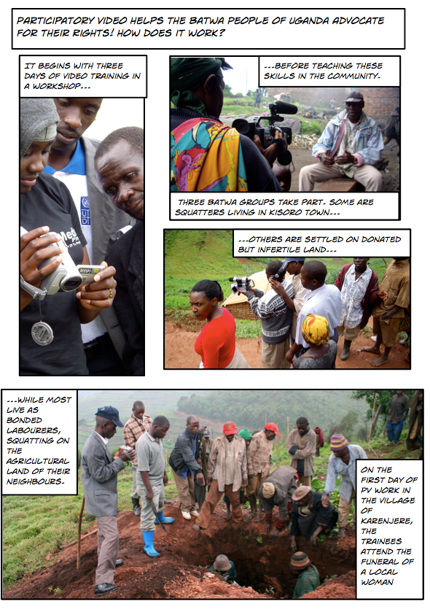
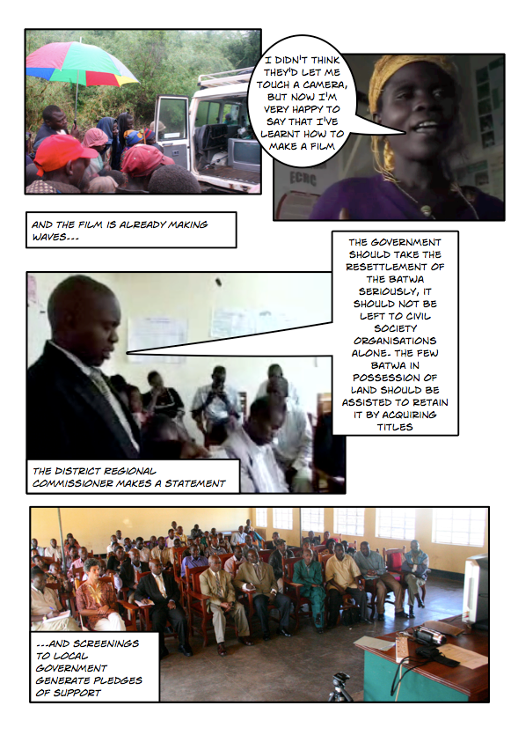
SGP approaches: Photo Stories

Slide 9
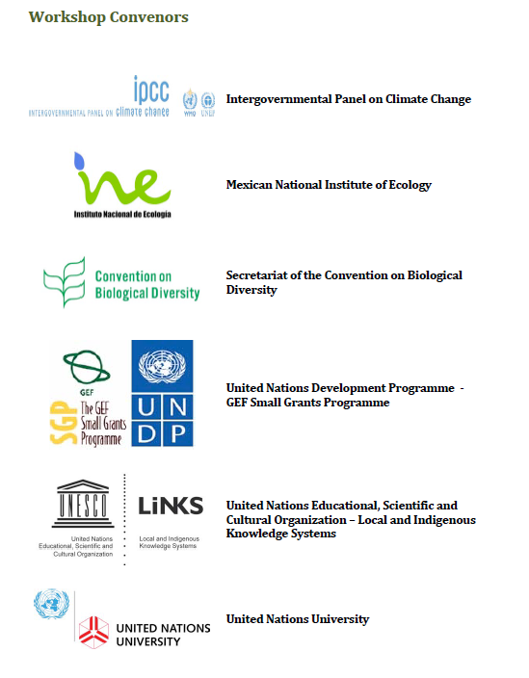
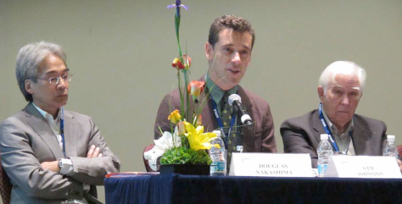
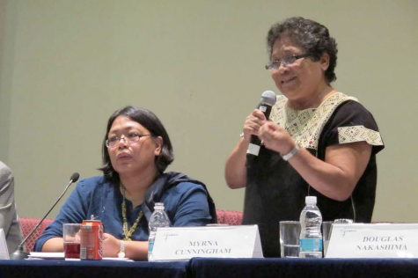
July 2011 workshop with UNESCO, UNU, CBD Sec & IPCC
Indigenous Peoples, Marginalized Populations and Climate Change: Vulnerability, Adaptation and Traditional Knowledge

Slide 10
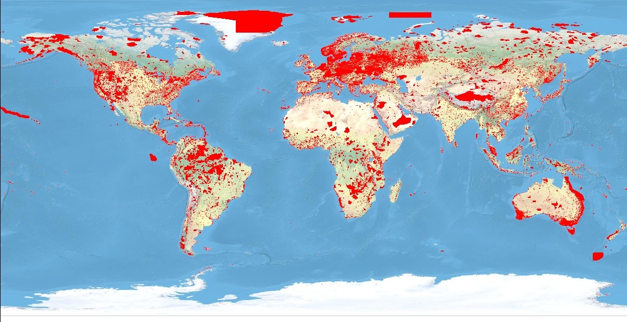
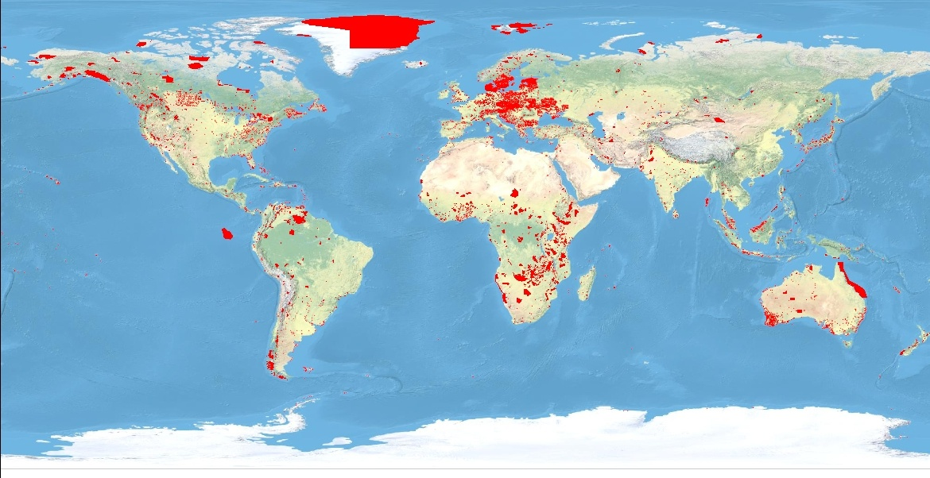
Global Extent of Protected Areas
Protected areas
in the WDPA:
1962 1,000
1980 40,000
2003 >100,000
2009 >130,000

Slide 11
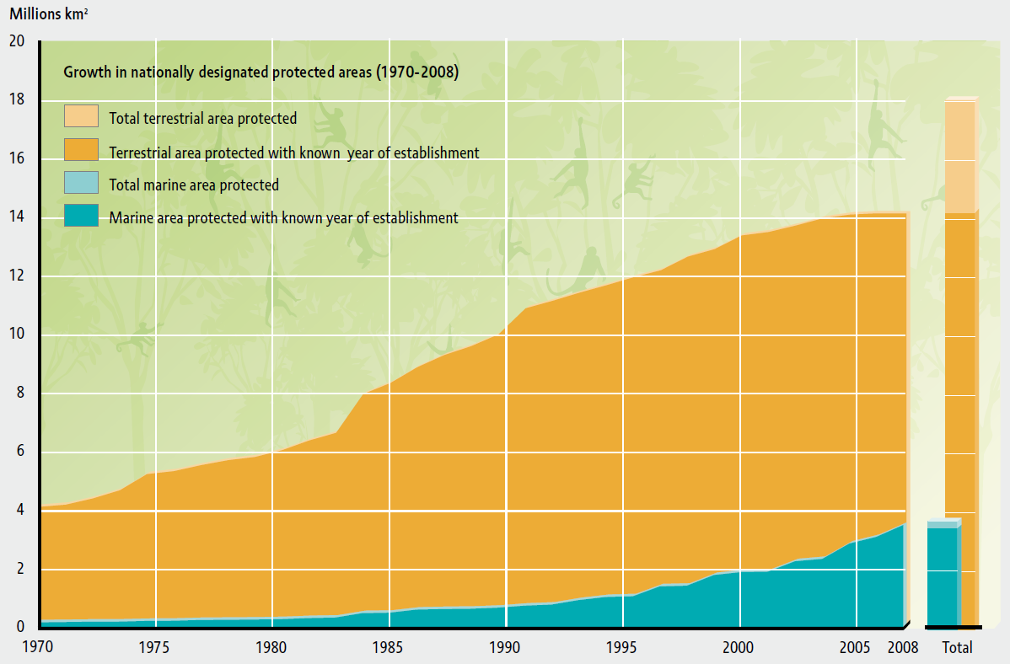
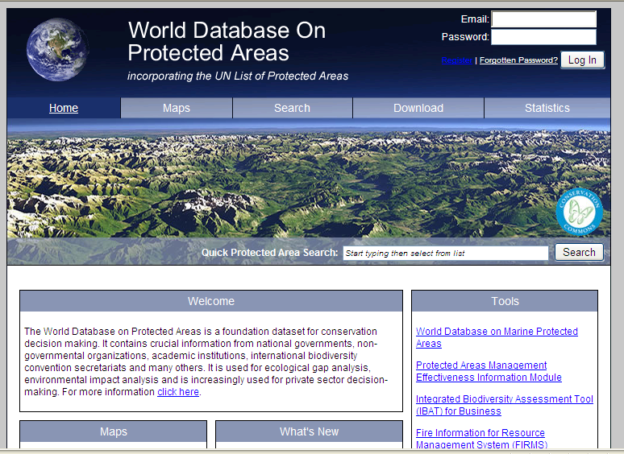
World Database on Protected Areas

Slide 12
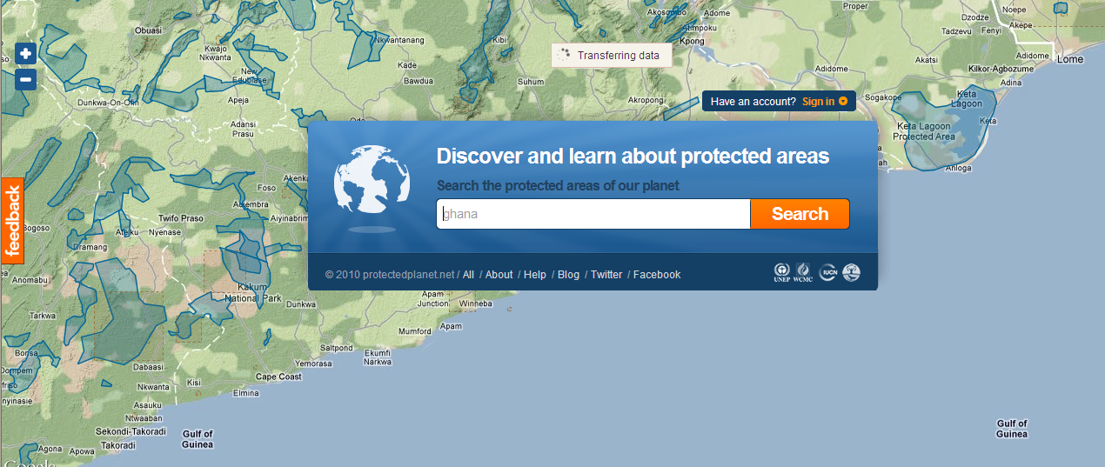
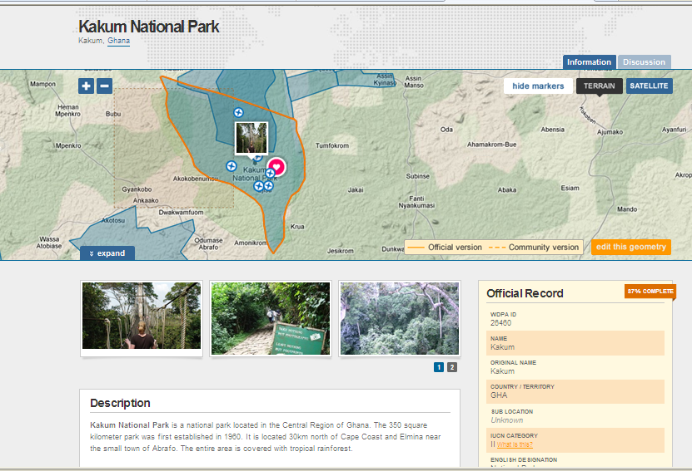
“Protected Planet” Portal
(protectedplanet.net)

Slide 13
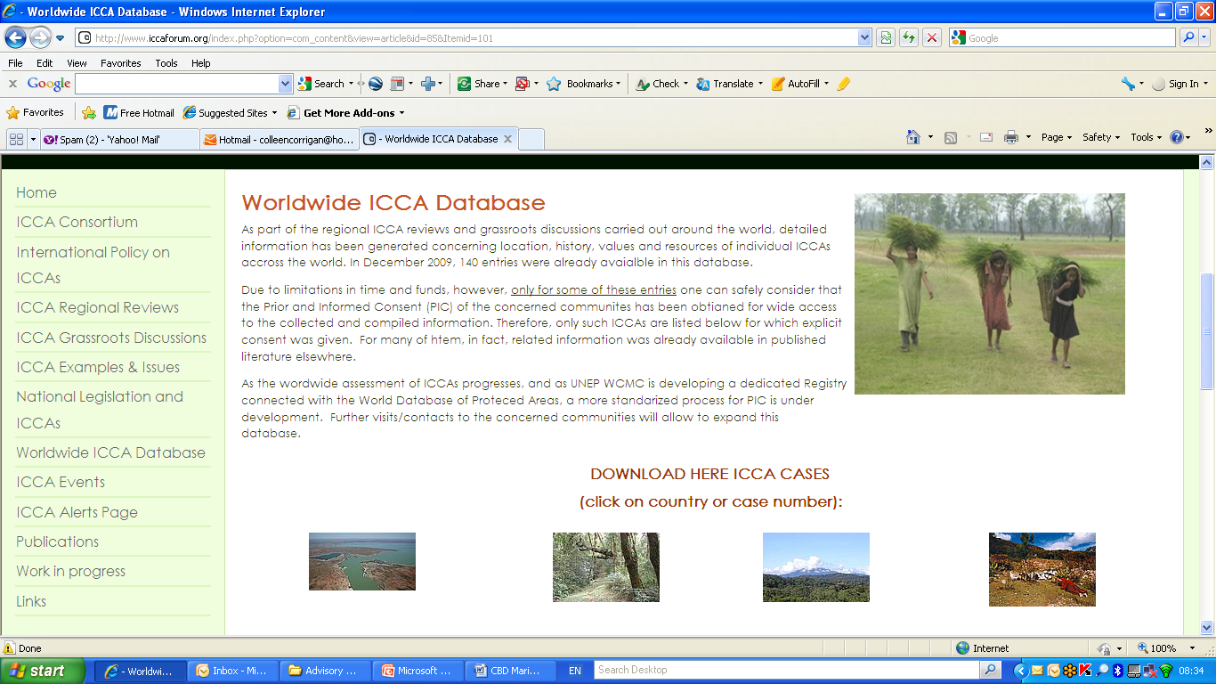
Global ICCA Registry - history
Global reporting estimates of protection lacks for most ICCAs
No global dataset on ICCAs
“Worldwide ICCA Database”- case studies from 18 countries
ICCA Registry initiated parallel to ICCA Consortium (WCC, Barcelona 2008)
Support provided to UNEP WCMC by UNDP/GEF SGP
Phase 1 Registry implemented (Feb 2009-Sept 2010)
Phase 2 (Oct 2010-Feb 2012)
Notes:
WDPA underestimates ICCA contributions: not reported in MDGs/UN List unless part of national system
Lack of synthesized knowledge on understanding ICCAs, esp at global level
2008: Idea/need for a Registry to assist with documentation, recognition of ICCAs
“Worldwide ICCA Database”- case studies from 18 countries
ICCA Registry initiated parallel to ICCA Consortium (WCC, Barcelona 2008)
Phase 1 Registry implemented
(Feb 2009-Sept 2010)

Slide 14


Protected Areas Governance Matrix
Governance Type | A. Government Managed Protected Areas |  |  | B. Co-managed Protected Areas |  |  | C. Private Protected Areas |  |  | D. Community Conserved Areas
IUCN Category (management. objective) | Federal or national ministry or agency in charge | Local/ municipal ministry or agency in charge | Government delegated management (e.g. to an NGO) | Transboundary conservation ( involving state agencies & others) | Collaborative management (various forms of pluralist influence) | Joint management (pluralist management board) | Declared and run by individual landowner | …by non-profit organisations (e.g. NGOs, universities, etc.) | …by for profit organisations (e.g. individual or corporate land-owners) | Declared and run by indigenous peoples | Declared and run by local communities
I - Strict Nature Reserve/ Wilderness Area
II – National Park (ecosystem protection; protection of cultural values)
III – Natural Monument
IV – Habitat/ Species Management
V – Protected Landscape/ Seascape
VI – Managed Resource

Slide 15
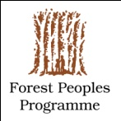



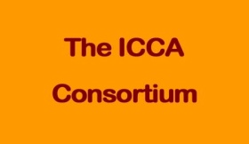
Global definition of ICCAs
IUCN Protected area definition:
“a clearly defined geographical space, recognised, dedicated and managed, through legal or other effective means, to achieve the long-term conservation of nature with associated ecosystem services and cultural values” (Dudley et al, 2008)
Indigenous Peoples & Community Conserved Areas and Territories (ICCAs):
“…natural and modified ecosystems including significant biodiversity, ecological services and cultural values voluntarily conserved by indigenous and local communities through customary laws or other effective means…” (WPC, Rec V 26, 2003)
Defining characteristics of ICCAs
  Community has close relationship with area
  Community holds power in decisions, by law or by practice
  Voluntary management achieves conservation
Notes:
The definition is tricky, there are lots of various terms that fall under this, such as locally managed marine areas, community forests, etc– it’s a broad term

Slide 16
Global enabling policies
Convention on Biological Diversity (CBD, 1992) recognition of role of local communities and indigenous peoples in conservation of biological (and cultural) diversity
Increasing recognition of role of community role in conservation
  5th IUCN World Parks Congress (2003)
  CBD Programme of Work on Protected Areas (2004)
UN Declaration on the Rights of Indigenous Peoples (Sept 2007)
“ICCA” term adopted by members of the IIFB (International Indigenous Forum on Biodiversity) and TILCEPA at COP9 (May 2008)
International exposure through IUCN WCPA Guidelines (2008)
Global ICCA Consortium (membership-based organisation) formed at the IUCN World Conservation Congress (Oct 2008)
CBD 10th Conference of Parties (Oct 2010) includes ICCAs in 2020 ‘Aichi targets’ for protected areas (17% terrestrial, 10% marine)
More clarity needed on relationship with PAs and “other area-based forms of conservation measures” referenced under the 2020 Aichi targets
Notes:
Differentiating between protected areas and ICCAs (based on recognition/support/power)
Governance (decisions) and management (actions) issues
Communities resistant to recognition and government involvement
In some cases, harsh realities are involved (ie extraction from area)
Climate change impact on ICCAs

Slide 17
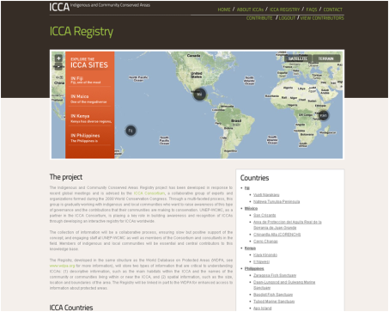
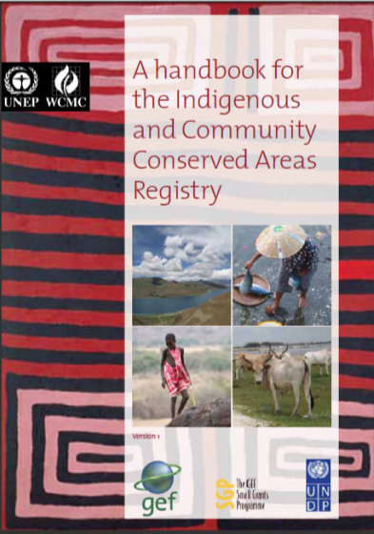
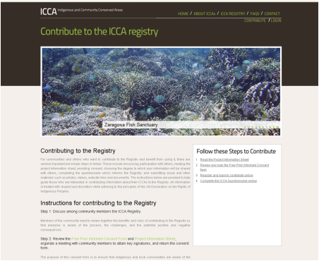
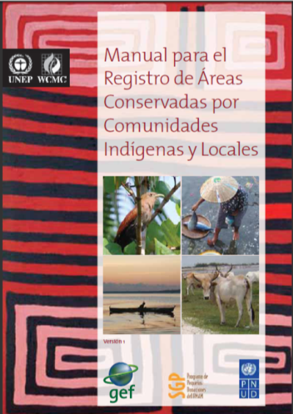
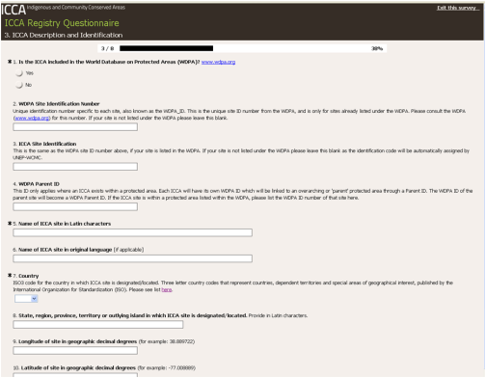
How to Contribute

Slide 18
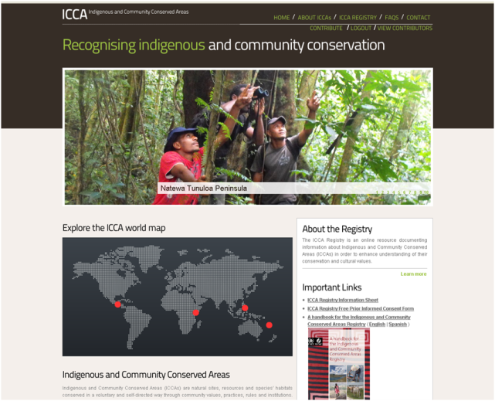
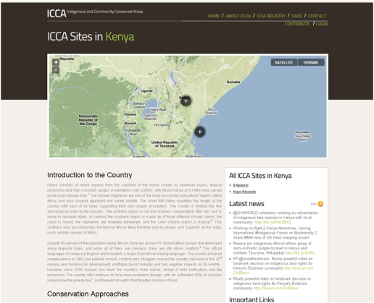
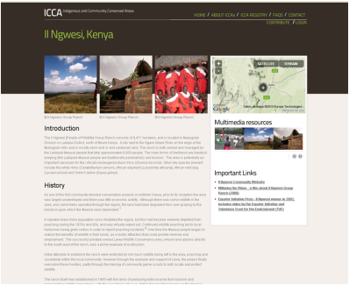
ICCA Website
Overview of project, links, global map
Basic information about each ICCA in pilot countries
Map and stats of ICCAs at national scale
Case study pages for featured ICCAs in pilot countries
  Context
  Participatory maps/videos
  Interviews
  Photos
  Stories
www.ICCAregistry.org

Slide 19
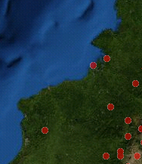
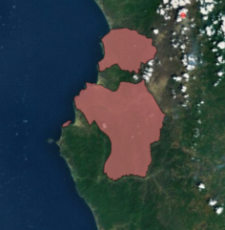
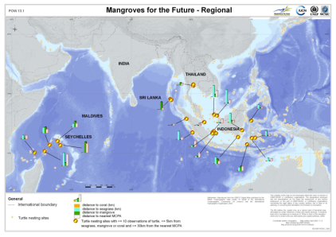
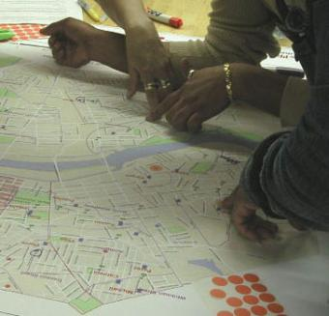
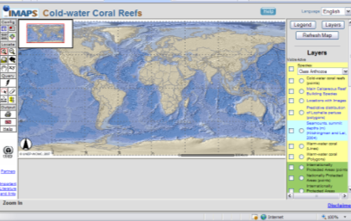
ICCA Registry information fields
Maps are generated to show the values of ICCAs
Key fields
Name (English and Indigenous/Local Language)
Community(ies)
Designation
Date of establishment
IUCN Protected Areas Management Category
Governance
Purpose
Physical Boundaries
Overlays with other data
  Habitat (Mangrove & Seagrasses, Forest cover, Coral reefs)
  Biodiversity (AZE, KBA, IBA, WWF Ecoregions, IUCN Red List)
  Global (Carbon stocks, Water valuation, Human health indices, Linguistic diversity)
GBF/TILCEPA
UNEP World Conservation Monitoring Centre
Notes:
19

Slide 20
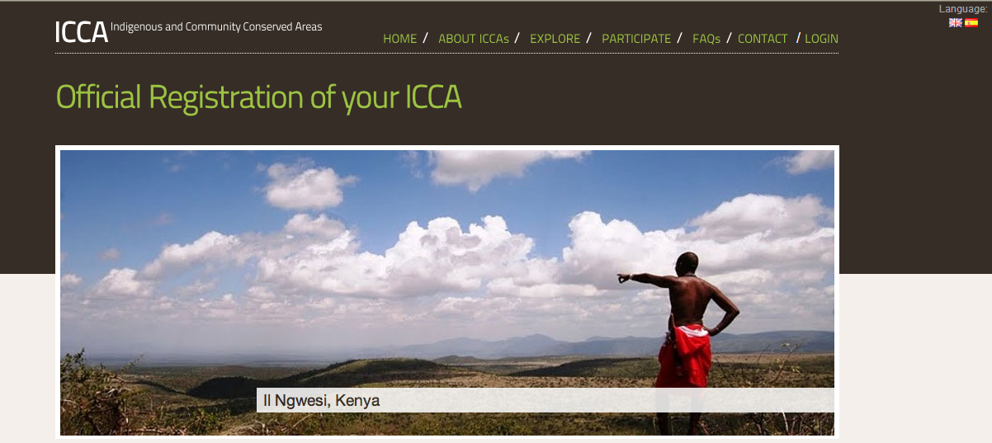
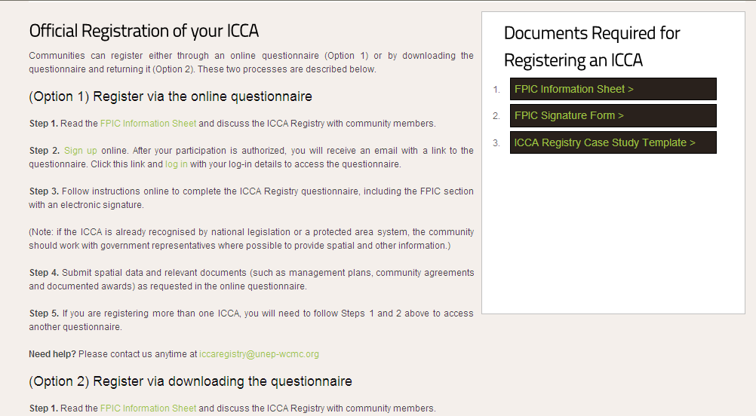
How to Register

Slide 21
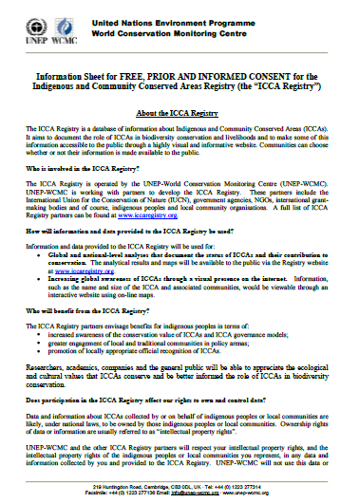
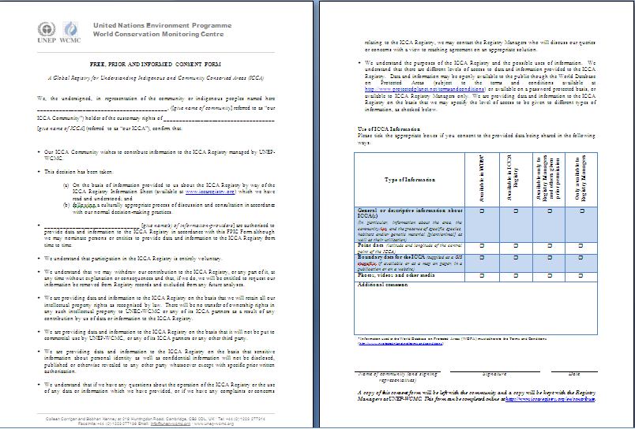
Free, Prior Informed Consent (FPIC)

Slide 22
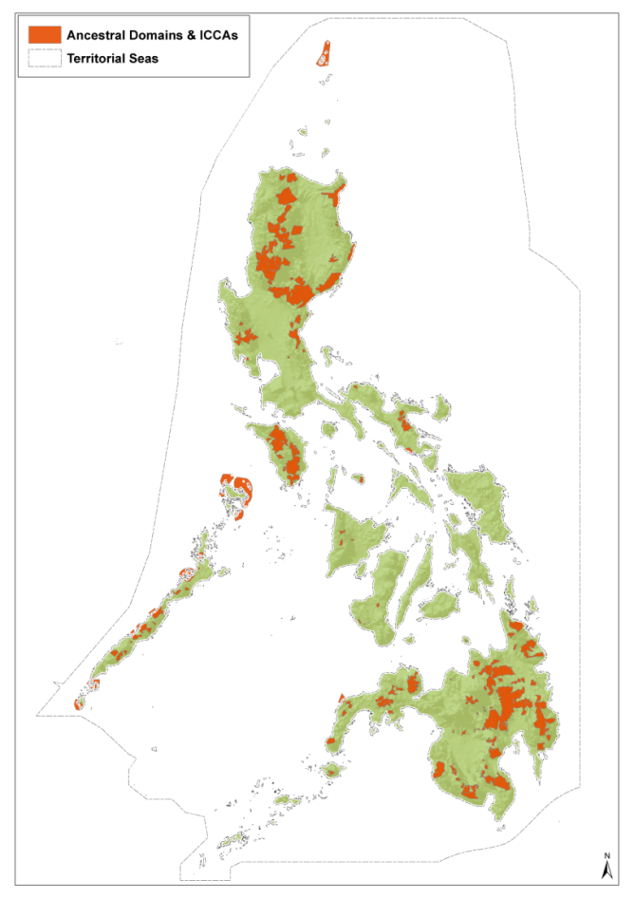
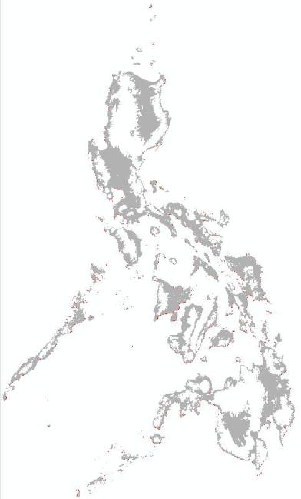
Innovative Mapping for Documenting Conservation
Philippines pilot study
Possible Indicators
Total area coverage
Carbon stocks
Endangered species and special habitats
Important Bird Areas, other
Human population
Sea level rise
Linguistic diversity
Crop diversity

Slide 23
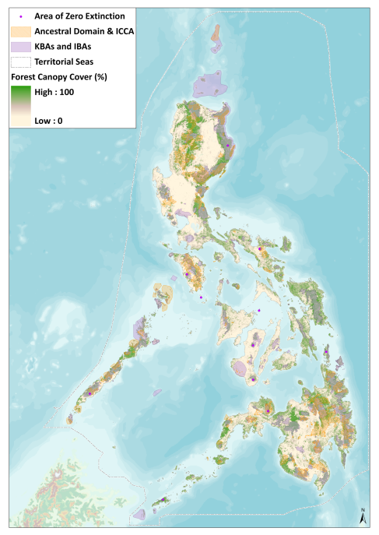
Philippine’s ICCAs
12.46% of the Philippines’ terrestrial areas and 0.44% of marine areas are covered by ICCAs (including Ancestral Domain) [550 records in total]. When ICCAs are combined with other protected areas, these figures jump to 21.12% and 1.58% respectively.
Over 75% of all Endangered and Critically Endangered marine and terrestrial IUCN Red List fauna species in the Philippines have ranges that extend into ICCAs.
10 out of the total 15 Alliance for Zero Extinction sites in the Philippines fall within 50 km of ICCAs, showing spatial relevance (1 out of 15 Alliance for Zero Extinction sites falls within an ICCA).
70.2% of terrestrial ICCA areas have closed forest cover (greater than 40% canopy cover), 19% higher than the Philippines as a whole.

Slide 24
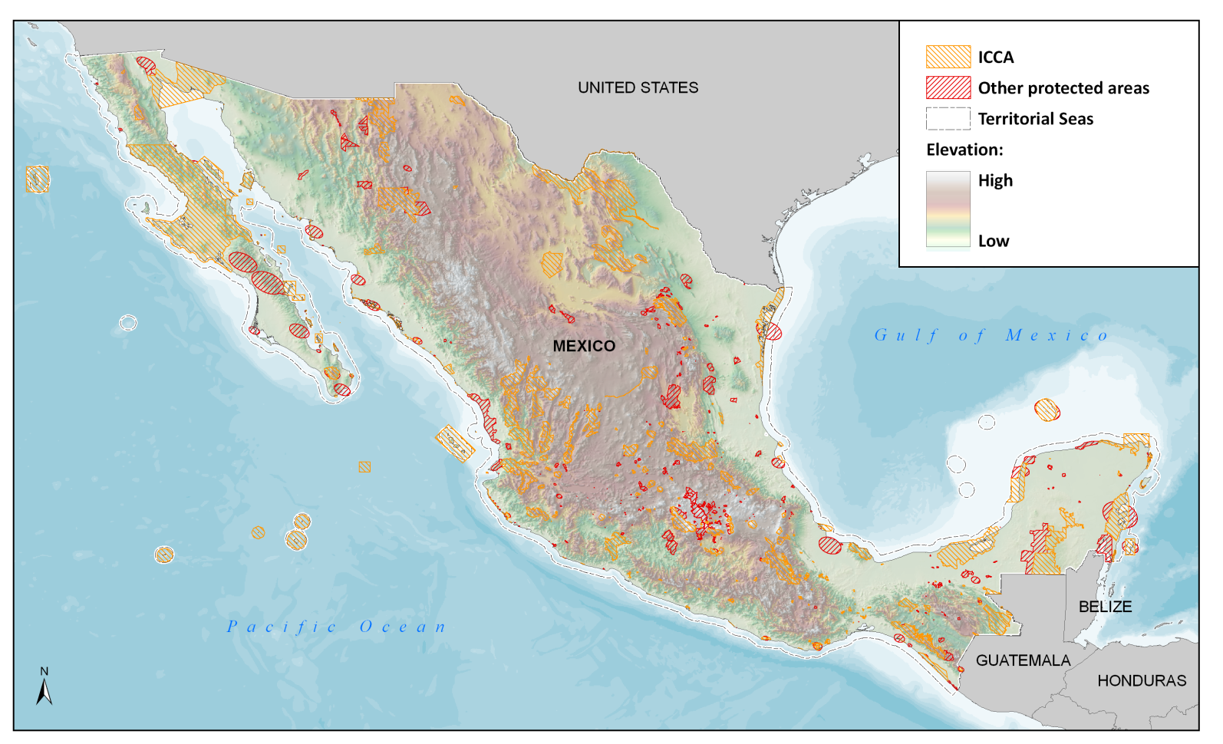
Mexico’s ICCAs

Slide 25
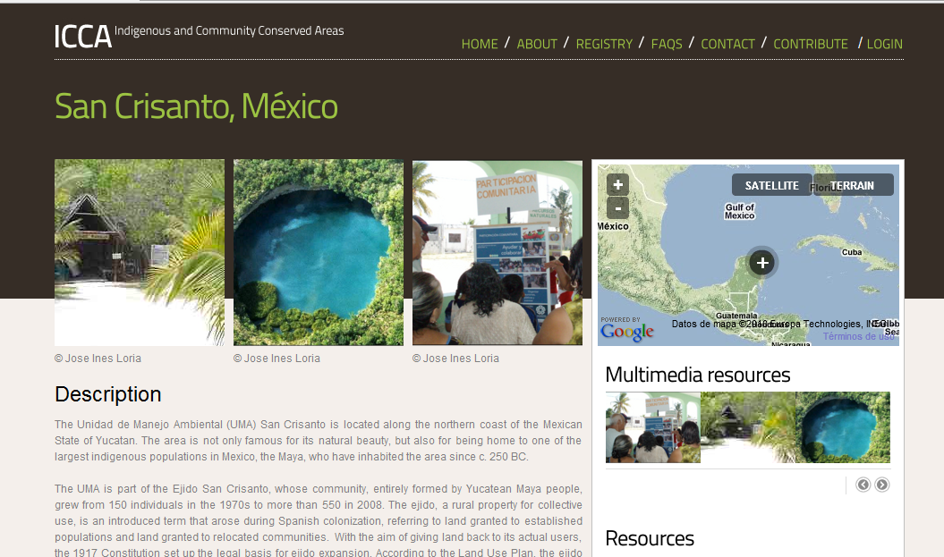
Case Study Example
“The publication of information and data will allow more people to know about our project. This will bring more interest and more visitors, and it is also a way to show the organizations that have supported us that we grew and we are still growing and their investment is benefiting both people and conservation. The publication on a website created by an important international organization helps raise the profile of our work and activities. Furthermore, it allows us to share our experience with other communities, to learn from their experience and support them through our experience. Along with other stories of other ICCAs it will also help show those who are skeptical that community conservation and development is possible.”
Jose Ines Loria – from the Unidad de Manejo Ambiental (UMA)
San Crisanto, Mexico

Slide 26
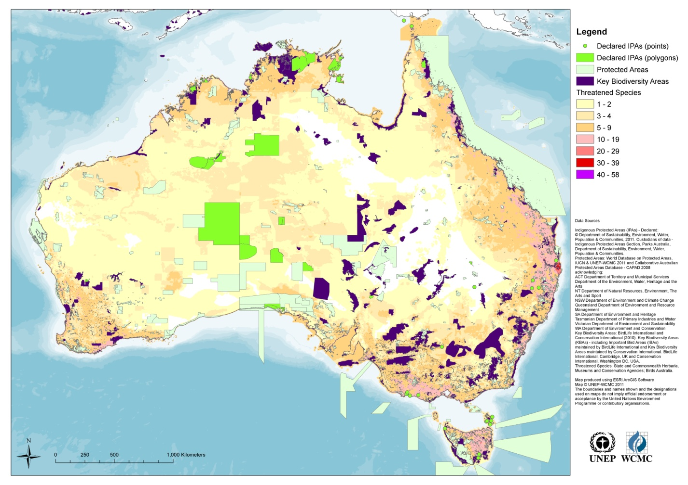
Australia Indigenous Protected Areas (IPAs) and Key Biodiversity Areas
Notes:
Question regards what other ICCAs exist in Australia and how to incorporate them into analysis?

Slide 27
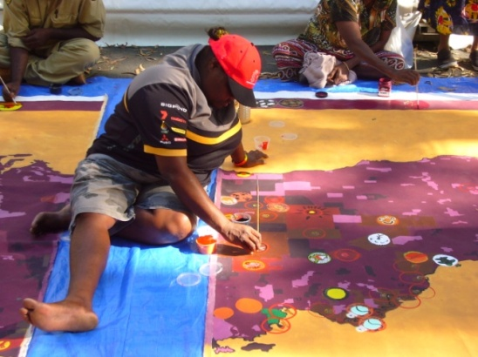
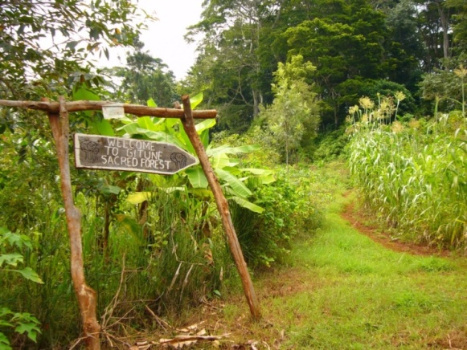
Current Registry status
(Phase 2; Oct 2010-Feb 2012)
Registry website content
Activities
16 interactive case studies on website
6 interactive country maps
New website content
22 country summaries
36 ICCAs registered in database
Interns converting data from ICCA Forum spreadsheets/
ICCA capacity-building workshop (Japan 2010)
Updated and expanded content in online ICCA Registry
National maps for at least 4 countries (UK, Australia, Ecuador, Guyana)
Contribution to at least 1 national level ICCA workshop or process (Aust)
Links with UN-REDD process, other UN agencies

Slide 28

Governance of ICCA Registry
Notes:
Diverse membership
Decisions by consensus

Slide 29

Local Action
Global Impact
Thank You

