Slide 1
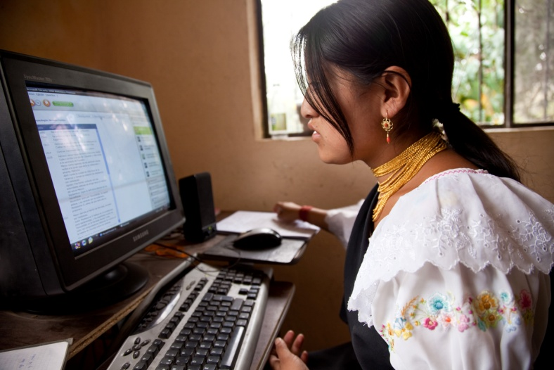
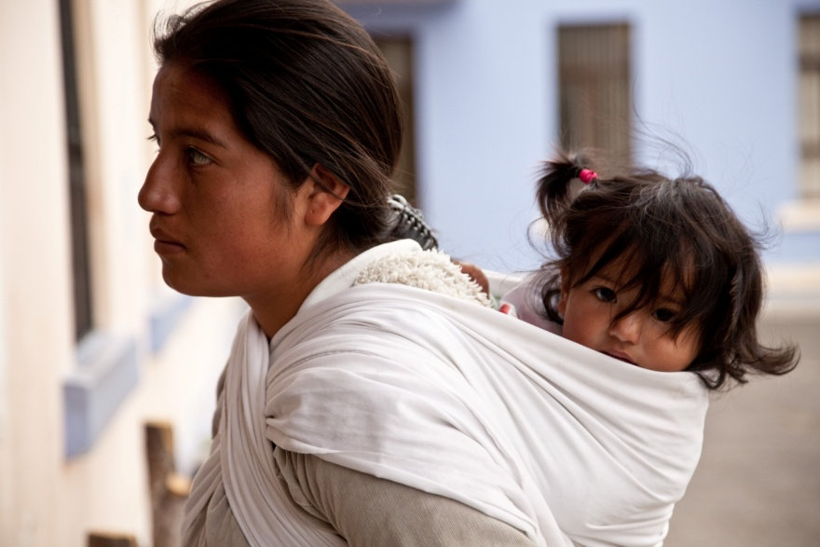

Empowering indigenous women and improving their access to intercultural maternal health services in the Andean region
UN Inter-Agency Support Group on Indigenous Peoples Issues
New York, November 2011
Martha N Murdock, FCI
on behalf of UNFPA LACRO, ENLACE CONTINENTAL and FCI

Slide 2




Mujer Indígena: Salud y Derechos
On behalf of project partners:
-UNFPA LACRO
- Enlace Continental de Mujeres Indígenas (Continental Network of Indigenous Women)
- FCI
Other core partners: CEPAL/CELADE, ORAS-CONHU
Spanish Government (AECID) support (2008 – 2011)
Enlace Continental de Mujeres Indígenas

Slide 3
Mujer Indígena: Salud y Derechos
Strengthen capacity of regional networks of indigenous women to influence policy making on gender equality, maternal health and reproductive rights
Strengthen sub/regional partnerships to promote culturally-sensitive strategies for reducing maternal mortality among indigenous women and promote the health systems use of these strategies
Notes:
“Empoderamiento de mujeres indígenas de América Latina para su incidencia en políticas públicas que garanticen el derecho a la salud sexual y reproductiva y a la equidad de género: Campaña de Promoción de la Salud Materna desde una Perspectiva Intercultural y de Derechos”

Slide 4
Initiative launched in response to the recommendations of the United Nations Permanent Forum on Indigenous Issues (5th and 6th sessions)
Report on the 5th session (2006)
Art. 48. The Permanent Forum, (...) further recommends that all relevant UN entities (...), as well as regional health organizations and Governments, fully incorporate a cultural perspective into health policies, programmes and reproductive health services aimed at providing indigenous women with quality health care, including emergency obstetric care, voluntary family planning and skilled attendance at birth.
Report on the 6th session (2007)
Art. 62. (..) The Forum encourages those agencies to share their experience in health programming for indigenous peoples with other relevant United Nations agencies working in the field.
Notes:
See full text
Informe sobre el V período de sesiones del Foro Permanente para las Cuestiones Indígenas (2006) .
48. The Permanent Forum, reaffirming the recommendations on health made at its
first, second and third sessions, further recommends that all relevant United Nations
entities, especially WHO, the United Nations Children’s Fund (UNICEF) and
UNFPA, as well as regional health organizations and Governments, fully incorporate
a cultural perspective into health policies, programmes and reproductive health
services aimed at providing indigenous women with quality health care, including
emergency obstetric care, voluntary family planning and skilled attendance at birth.
In the latter context, the roles of traditional midwives should be re-evaluated and
expanded so that they may assist indigenous women during their reproductive health
processes and act as cultural brokers between health systems and the indigenous
communities’ values and world views.
Informes sobre el VI período de sesiones del Foro Permanente para las Cuestiones Indígenas (2007)
Art. 62. Reports received by the Permanent Forum indicate that United Nations agencies, notably UNICEF and the United Nations Population Fund (UNFPA),
incorporate indigenous issues into their health programming at the country and
regional levels and apply culturally sensitive approaches to health delivery. The
Forum encourages those agencies to share their experience in health programming
for indigenous peoples with other relevant United Nations agencies working in the
field.
63. Given the rapid increase in diabetes among indigenous peoples, the Permanent

Slide 5
Building strategic synergies
Indigenous women unmet need of maternal health (MH) serivces
Availability of culturally responsive MH services
With Continental Network of Indigenous Women:
Identify priorities for improving SRH and promote access to services
Develop advocacy strategies that respond to needs
Build advocacy capacity and promote dialogue with the health sector
With Ministries of Health:
Review MH norms and regulations to assess degree of inclusion of intercultural approach
Identify best practices
Build consensus around basic standards for MH culturally responsive services.
Notes:
En el marco del proyecto Mujer indigena, salud y derchos, hemos trabajado en dos sentidos:
Por un lado, acompañando el proceso de fortalecimiento de la agenda de SSR en el seno de las organizaciones indigenas, aportando nuestro expertise en materia de diagnosticos participativos, desarrollo de materiales y de programas de sensibilizacion, etc
Por otro lado, hemos acompañado a los Ministerios de Salud en el proceos de analisis de los modelos de atencion interculutral a la salud materna que han desarrollado a traves de norams y protocolos de atencion.

Slide 6
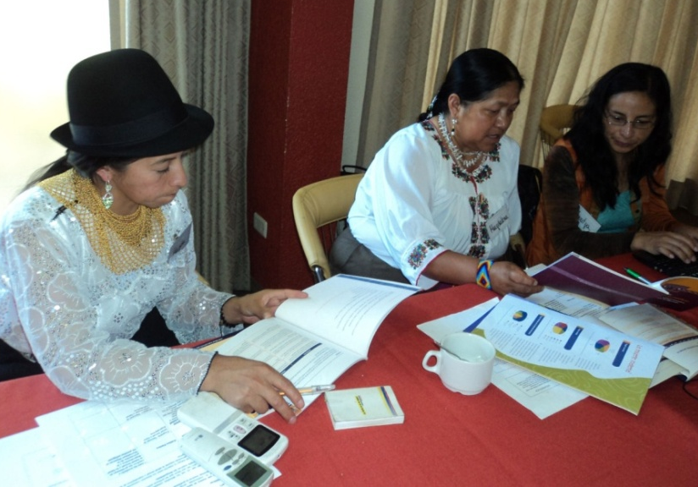
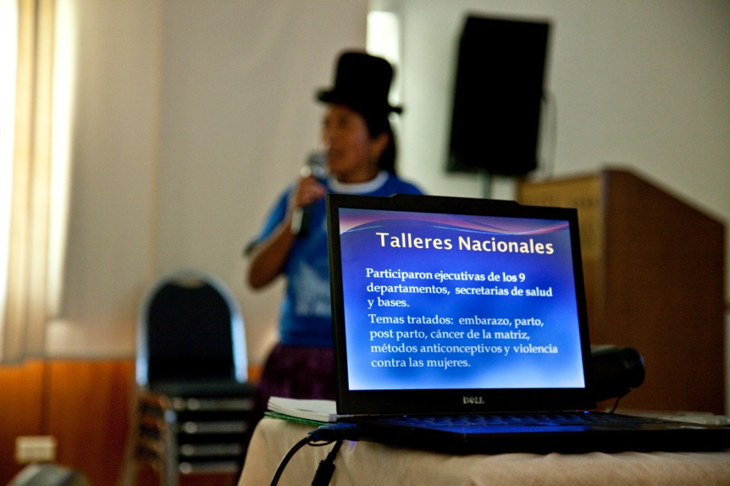
Steps in Process
UNFPA LACRO, with Ministries of Health (Bolivia, Ecuador, Peru, Guatemala and Honduras), Enlace Continental and FCI, worked to generate advocacy and policy dialogue with indigenous women's organizations to
Empower indigenous women in maternal health and gender
Advance maternal health policies and strengthen their implementation.

Slide 7
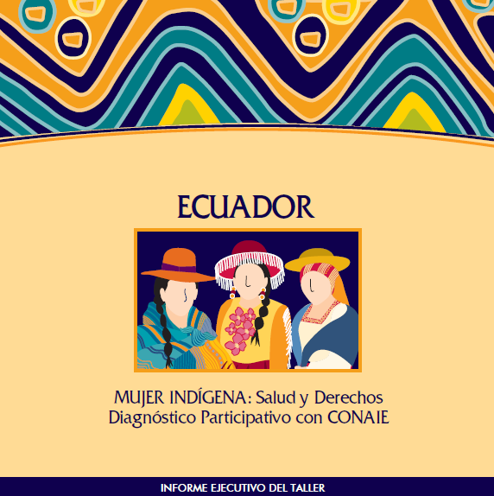
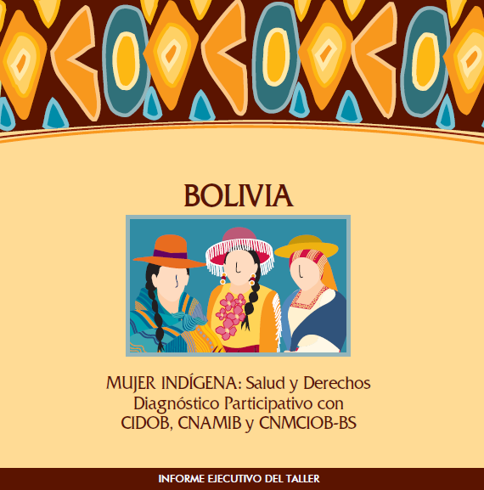
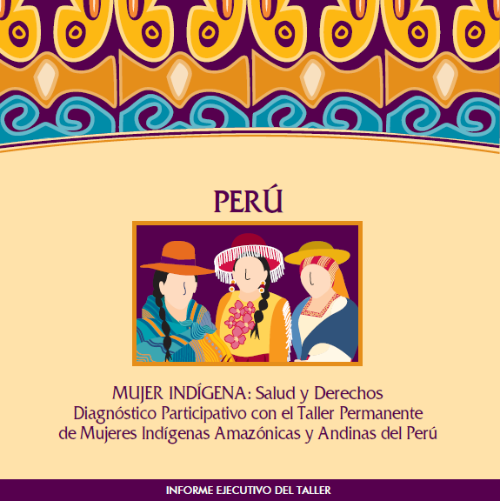
1. Participatory assessments of SRH/MH priorities with indigenous women's organizations. Bolivia / Ecuador / Peru
Notes:
Por ej. La Agenda Política y Estratégica de las mujeres indígenas y originarias de Ecuador incluye como uno de sus cinco ejes estratégicos los derechos sexuales y reproductivos y el derecho a una vida libre de violencia.

Slide 8
2. Capacity Building in Advocacy
Continental Network of Indigenous Women:
Validating key messages
Mapping advocacy opportunities
Capacity building with IWN
South to South exchange
Position RH and gender of IW in regional and global alliances
UNFPA and Technical Partners (FCI, CEPAL):
Advocacy Tools:
Knowledge sharing in RH
Facilitate linkages with policy bodies and technical partners (PAHO)
Supporting policy reform
Monitoring and resource mobilization

Slide 9
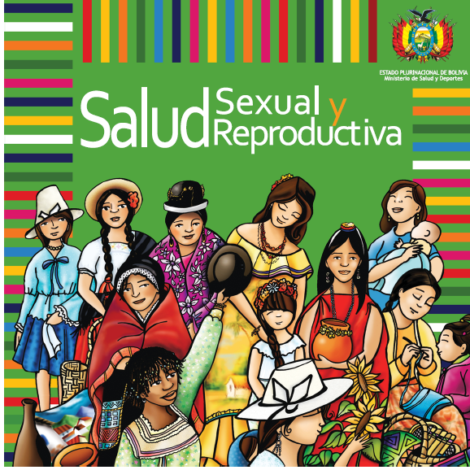
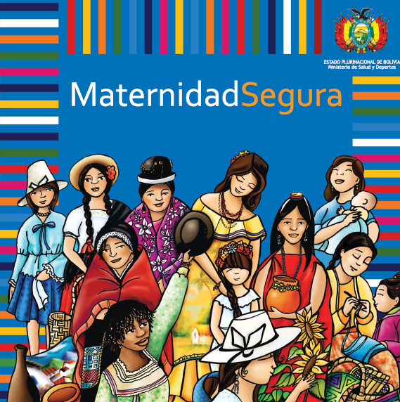
3. Participatory development of tools and methodologies to strengthen institutional capacity of indigenous women’s organizations
Participatory development of advocacy and educational materials.
Capacity building in SRH : MH, contraception, cervical cancer, etc.
Development of outreach and monitoring campaigns
Diversifying leadership and involving male leaders

Slide 10
4. Fostering Sub-Regional Dialogue
Creating venues for regional and national political dialogue, to build awareness and linkages between indigenous women organizations, political bodies and technical agencies
Regional technical meeting on intercultural approach in maternal health regulations. Quito, Sept 2010.
High level meeting on intercultural health for indigenous women. Lima, June 2011
Regional technical meeting with indigenous leaders on advocacy, Santa Cruz, March 2011

Slide 11
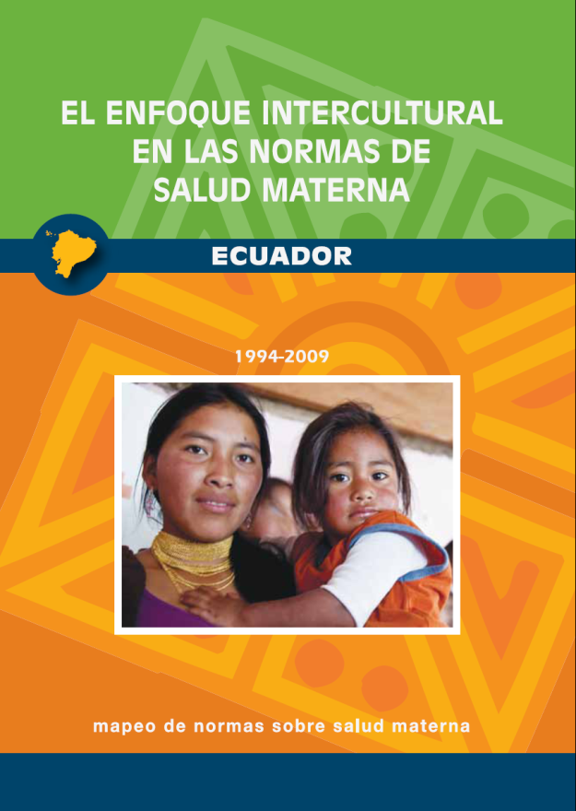
5. MAPPING of maternal health norms: degree of inclusion of cultural factors
(BOL / ECU / PER / GUAT / HON)
Participatory review of how MH norms and regulations incorporate cultural components of quality of care
Validation of findings with IWN, MOH and key stakeholders
Mapping findings to foster dialogue between regulation units of MOH and intercultural care departments, around maternal and reproductive health.
Notes:
Mapping to analyze how culturally-pertinent maternal health norms issued by health authorities in Ecuador, Bolivia, Peru, Guatemala and Honduras have helped improve access among indigenous women seeking maternal care in public health services, and to identify gaps and areas for improvements.

Slide 12
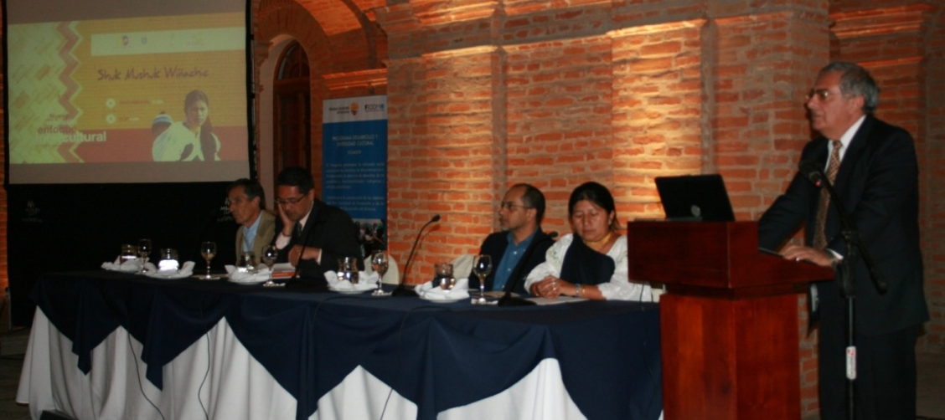
6. Participatory review of intercultural maternal health services: norms, guidelines and degree of implementation
National review – Regional trends
Regional recommendations (inter-ministerial entity linking Ministries of Health in Andean Region: Organismo Andino de Salud, ORAS-CONHU)

Slide 13
7. Advocacy for high level political commitment to increase efforts to reduce maternal mortality among indigenous women
Lima Declaration, June 2011. Salud sexual y reproductiva intercultural: por la reducción de las muertes maternas en mujeres indígenas, subscribed by MOH of Bolivia, Ecuador, Guatemala, Perú and Venezuela
Declaración de las Mujeres Indígenas de América Latina sobre Salud Reproductiva Intercultural, June 2011. Subscribed by indigenous women’s organizations from ARG, BOL, ECU, GUAT, HON, PERU.
Declaración de Cajamarca, Octubre 2011. Salud intercultural desde los pueblos indígenas. Signed by the above, plus BRA, CHI, MEX and PAR.

Slide 14
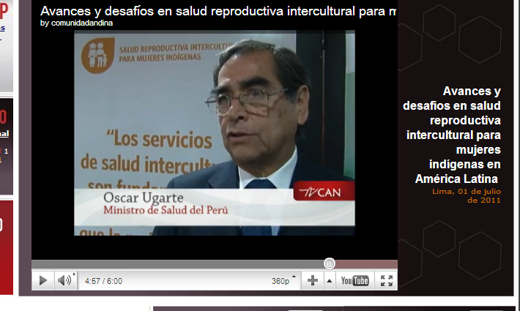
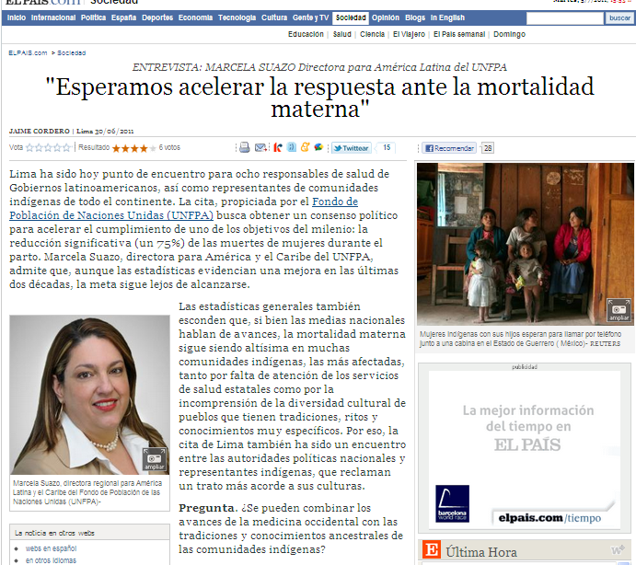
8. Regional high level advocacy campaign to build awareness and promote policy dialogue.

Slide 15
9. Dialogue on basic standards for intercultural maternal health services
Development of a proposal of basics standards of intercultural maternal health services, to promote quality of care, ensure right to health, strengthen monitoring and evaluation of services.
Led by MOH of Bolivia and Ecuador, input ORAS-CONHU
Technical input UNFPA, PAHO

Slide 16
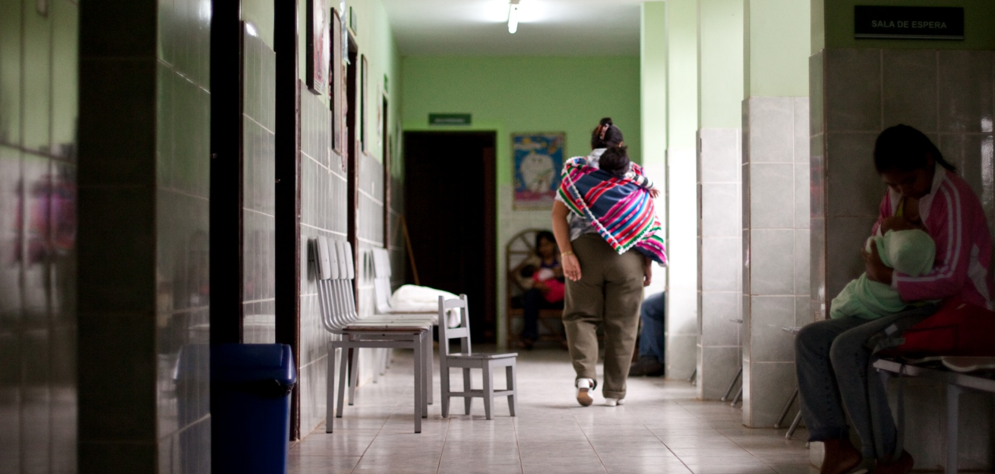
Outcomes

Slide 17

RH and rights positioned in the agenda of Indigenous Women’s Networks (IWN)
Increased knowledge on indigenous women’s right to maternal health in multicultural contexts among all stakeholders
Strengthened advocacy capacity of IWN in maternal health and gender
Social monitoring systems by IWN strengthened.
New advocacy venues for policy dialogue created (regionally and nationally)
Diversified leadership on these issues
Notes:
Comisión de Salud Intercultural del Organismo de Salud en la Región Andina (ORAS-CONHU); Enlace Continental;
MINSA: autoridades sanitarias normativas e instancias a cargo de salud intercultural

Slide 18
Advances in Policy Development in Health Sector
Identification of regulatory gaps
Development of shared recommendations for strengthening normative framework
Application of new constitutional frameworks that recognize cultural diversity

Slide 19
Enabling Sub-Regional Context for Joint Programming
Increased attention to cultural barriers to maternal health at regional and global levels (UN, The Lancet, MMR Interagency Group, PAHO Regional Plan for MMR, etc.)
Maternal mortality and RH of indigenous women recognized in agenda of human rights, gender, youth, demographic and other technical partners
High-level political opportunities created to monitor, advance and operationalize intercultural models of maternal health.
Notes:
Artículo en The Lancet sobre SM e IC en Ecuadro; llevando el tema a Women Deliver 1 y 2; a GTR y a conferencia mujers liders. FCI trabaja para mantener necesidades especificasde mujers indigenas en la agenda global de SM
Como org de advoacy, FCI tiene años de participar e impulsar espacios inter-sectoriales de cooperacion en materia de Salud Materna.. La mesa de maternidad y nacimiento seguros, en Bolivia, es un ejemplo de nuesetra participacion sostenida y continuada.
En 2011 con cooperación de MINSAS, y con ORAS CONHU, trabajamos en definición de indicadores básicos de modelos de atención a la salud materna con enfoque intercultural, a ser validados por MINSAS para incorporación progresiva en políticas públicas de salud (Guatemala, Honduras, Bolivia, Perú y Ecuador)
El proyecto ha permitdo que el know how acumulado pro Enlace, llegue a las organizaciones de base que conforman esta red regional
(parto vertical, atencion liguisiticamente diferenciada en consejeria de PF, respeto a practicas culturales inocuas, entrega de la placenta, etc)

Slide 20
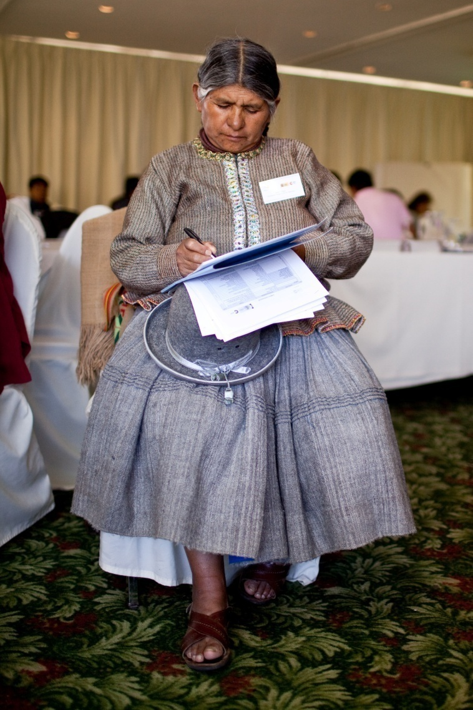
“Poder hablar de nuestra salud, lo importante de hablar sobre la salud de las mujeres: yo decido, soy dueña de mi cuerpo.”
Justa Cabrera, CNAMIB
"
¡Gracias!

