Slide 1
Realising the Rights of Indigenous Children

Slide 2
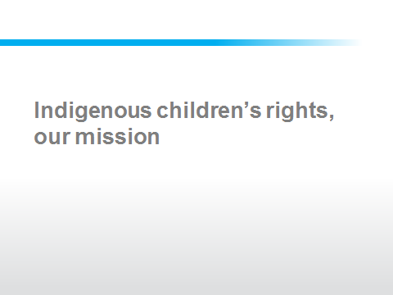

Slide 3
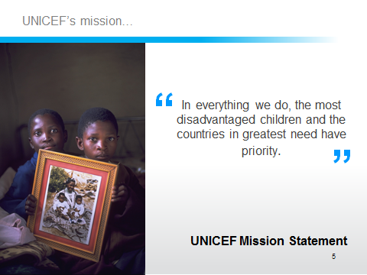

Slide 4
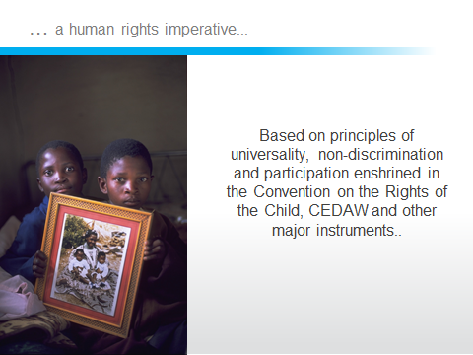

Slide 5
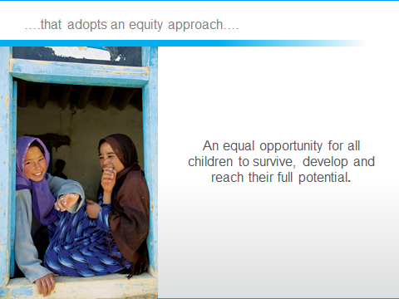

Slide 6
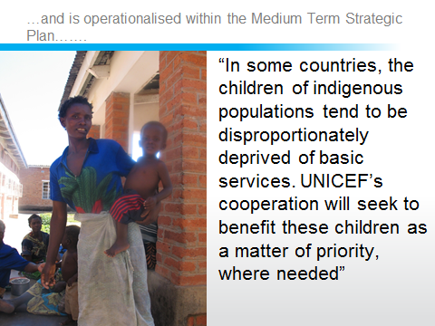

Slide 7
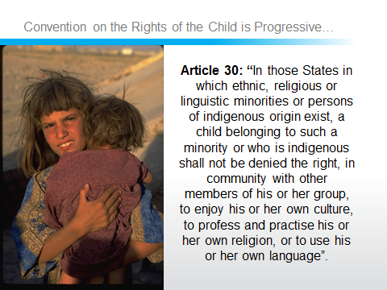

Slide 8
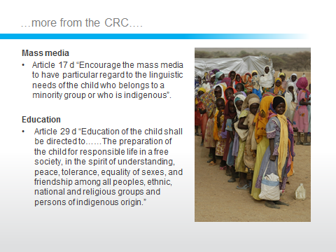

Slide 9
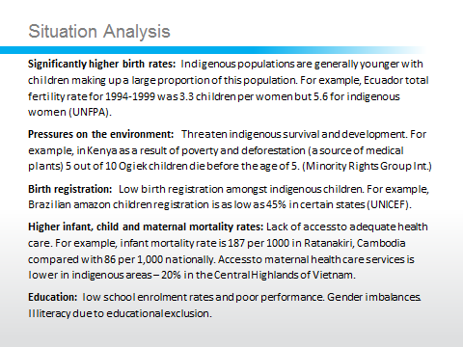

Slide 10
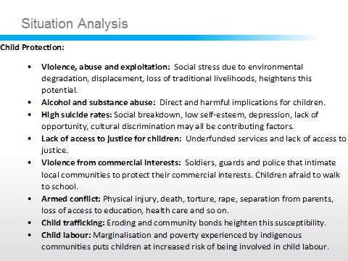

Slide 11
MTSP Supports Indigenous Child Rights
MTSP Focus Area’s 2006-13: | Interventions:
FA 1: Young child survival and development. | Development of primary health care services in indigenous areas and ensure that these services are made accessible, affordable and culturally acceptable.
FA 2: Basic education and gender equality. | Promotion of intercultural / bilingual education that is gender sensitive to promote access for girls and promotes opportunities for participation.
FA 3: HIV / AIDS and children. | Support for the training of health care staff and civil society organisations. Health education content will take account for indigenous beliefs, practices and sensitivities about illness, sex and reproduction.
FA 4: Child protection from violence, exploitation and abuse. | Promote birth registration and respond to violence, abuse and exploitation of children by strengthening family, kinship and community networks e.g. addressing alcoholism within communities. Education and community awareness is most effective at addressing child labour and juvenile justice measures should promote dignity and worth. Trafficking and sexual exploitation – awareness campaigns, social mobilisation and by tackling poverty and marginalisation.
FA 5: Policy advocacy and partnerships for children’s rights. | Support governments in monitoring the status of indigenous rights. Evidence based programme needs to be supported by more valid and accurate information.

Slide 12
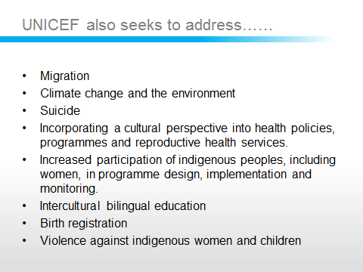
Innocenti and Forum Report

Slide 13
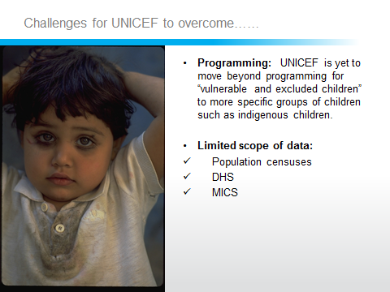

Slide 14
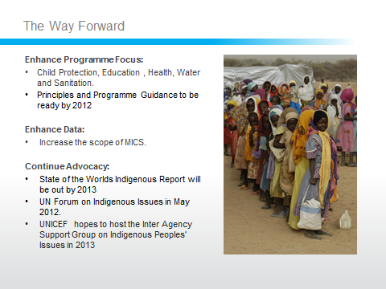

Slide 15
Thank You.

