Slide 1

Indigenous Peoples and Population Dynamics in Latin America
Fabiana Del Popolo
CELADE-Population Division
ECLAC
2011 Annual Meeting of the UN Inter- Agency Support Group on Indigenous Peoples Issues
New York, November 21 – 23rd, 2011

Slide 2
Background Framework
Latin America is a multiethnic and pluricultural region: more than 670 indigenous groups with enormous diversity
Indigenous peoples constitute active political and social actors: demands for recognition
Exists a minimum standard of rights (ILO Convention No. 169 y United Nations Declaration):
Right to be free from discrimination;
Right to cultural integrity;
Right to property, use, control and access to lands, territories and resources;
Right to development and social well-being;
Right to political participation, free, previous and informed consent

Slide 3
New and increasing demands for information
The demand for information, a recurring theme for governments, indigenous organizations and international organizations: essential technical tool for the design, implementation and monitoring of public policy and undeniable political utility
Importance of socio-demographic information, specially from census: who, how many and where are indigenous peoples constitute basic inputs for policies and programs.
In particular, demographic dynamics and their inherent components – fertility, mortality, and migration – sustain the biological and socio-cultural reproduction of indigenous peoples

Slide 4
Data sources
Census: among 20 countries in Latin America, 16 of them counted indigenous peoples (or population) in the 2000 census decade. It will be 17 in 2010 decade.
Household and Demographic and health surveys: 8-10 countries in recent surveys (sample size limitations)
Education and health registries: 1 country, Brazil with systematic processing., and local experiences. In health: some advances in 5 countries (Chile, Colombia, Ecuador, Guatemala, Venezuela)

Slide 5
Indigenous Peoples and censuses
Notes:
- All countries use self-identification criteria, except Peru.
What do we measure using Self-identification?
Semantic problem: diversity in the formulation of questions and their response categories
Sense of belonging: whether the person belongs to an indigenous people, indigenous group, or indigenous ethnicity (the term changes in each country, usually mention people [pueblo]; culture.
Included along with identification of ethnic and racial categories.
Only racial dimension through use of perceived phenotypical categories.
Difficulties in measuring progress: socio-historical context and methodological issues (changes in the questions and their impact on capturing the indigenous populations and therefore, on indicators).

Slide 6
General balance 2010 census based on international and regional recommendations
  Self –identification criteria: review and improvement of the questions , all countries.
  Other dimensions, as indigenous language, territories and ancestors, cultural perspective: improvement and new questions (Ex. Brazil, Chile, Ecuador, Mexico)
  Cartography that allows the reconstruction of indigenous territories: ex. Brazil and Costa Rica.
  Census process, participation, training, campaigns and institutionalization: important improvement!

Slide 7
Indigenous population more than 28 millon, 2000 census decade

Slide 8
Indigenous population, 2010 decade: growth due to demographic components and an increase in self-identification

Slide 9
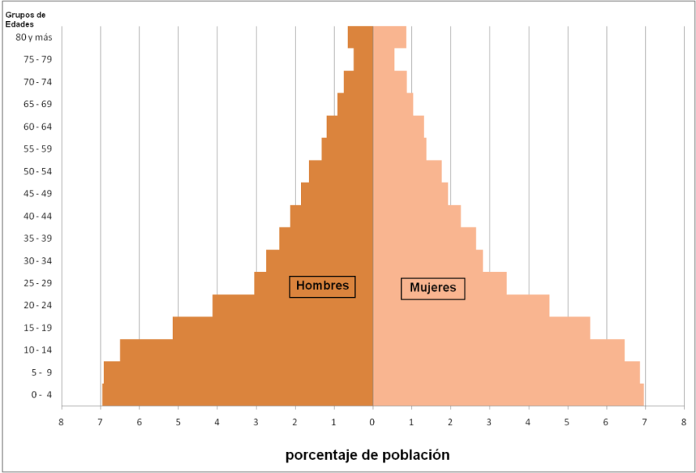
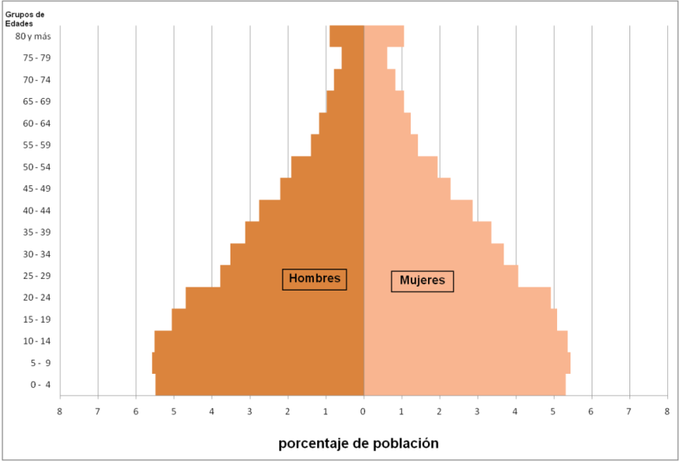
Panama 2000
Ecuador 2001
Indigenous
Indigenous
Non Indigenous
Non Indigenous

Slide 10
Fertility
Total fertility rate, 2000 census decade

Slide 11
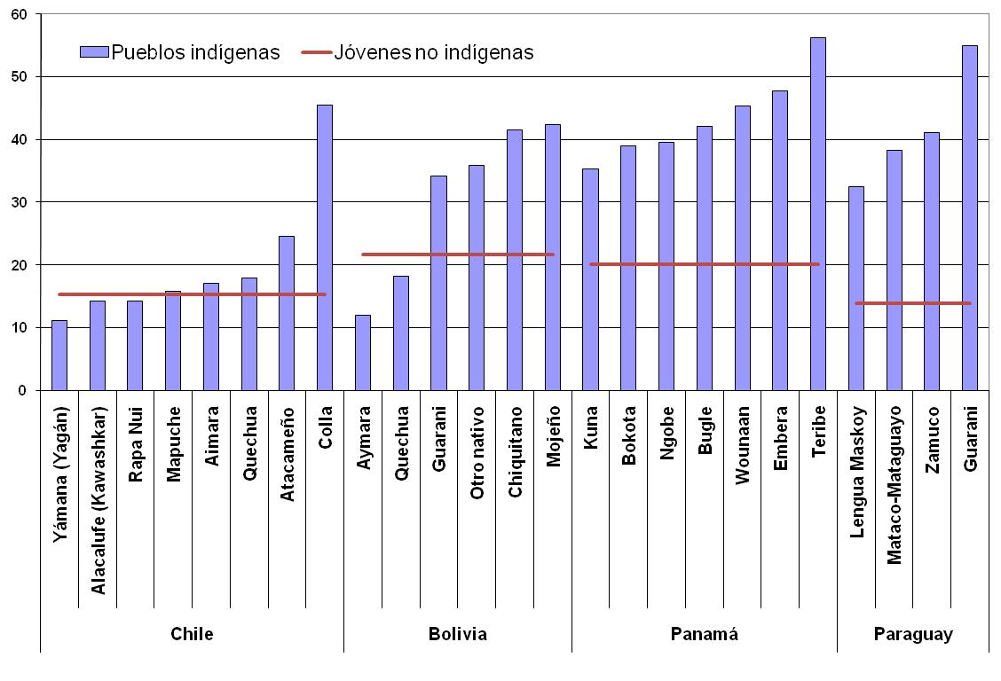
Percentage of youth (15-19 years old) that are mothers, rural areas, 2000 census decade

Slide 12
Recuperación demográfica y fecundidad: entre derechos individuales y colectivos
Parque Indígena do Xingu, Brazil
Indigenous People | Indigenous Population / year |  |  | Total fertility rate | Median Age at first child
Yudjá | 1842 | 1967 | 2007 | 2000-2007 | 2000-2007
 | 2000 | 58 | 306 | 8,8 | 16,8
Ikpeng | 1960 | 1 968 | 2007 | 2000-2007 | 2000-2007
 | 130-150 | 50 | 359 | 6,4 | 15,1
Source: Pagliaro et all (2010)

Slide 13
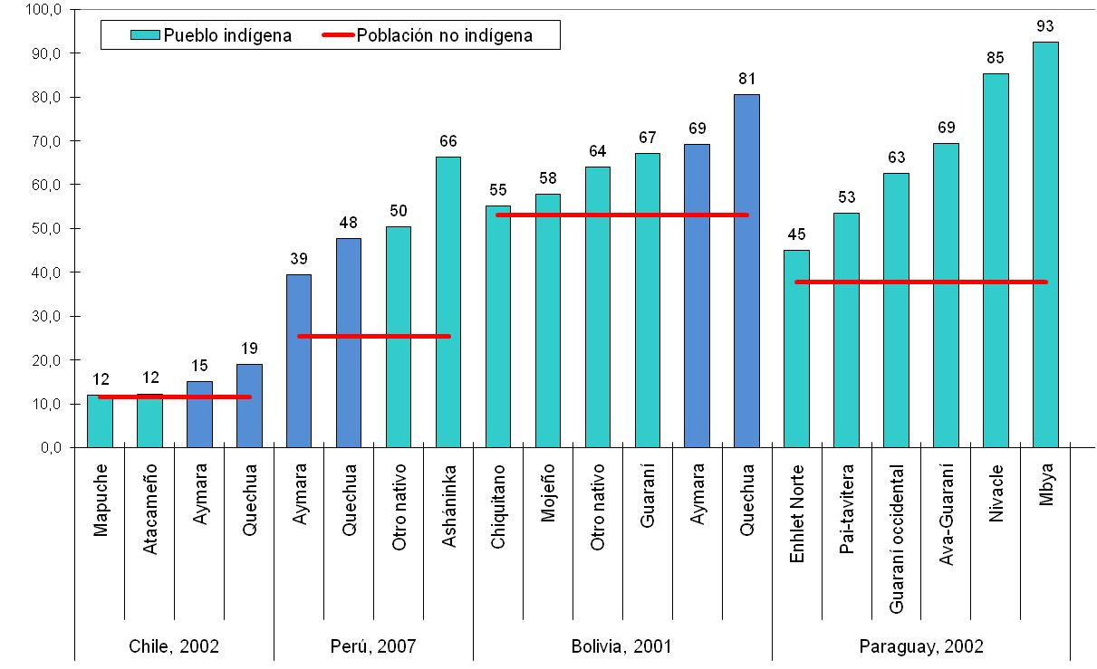
Mortality
Infant mortality rate (per thousand), 2000 census

Slide 14
Spatial distribution, internal and international migration

Slide 15
Population distribution according to urban-rural residence, indigenous-non indigenous

Slide 16
Percentage of indigenous migrants between major administrative divisions in the five years prior to the census, by age groups

Slide 17
Percentage of indigenous and non-indigenous international immigrant s born in bordering or other countries, by country of residence, 2000 census decade

Slide 18
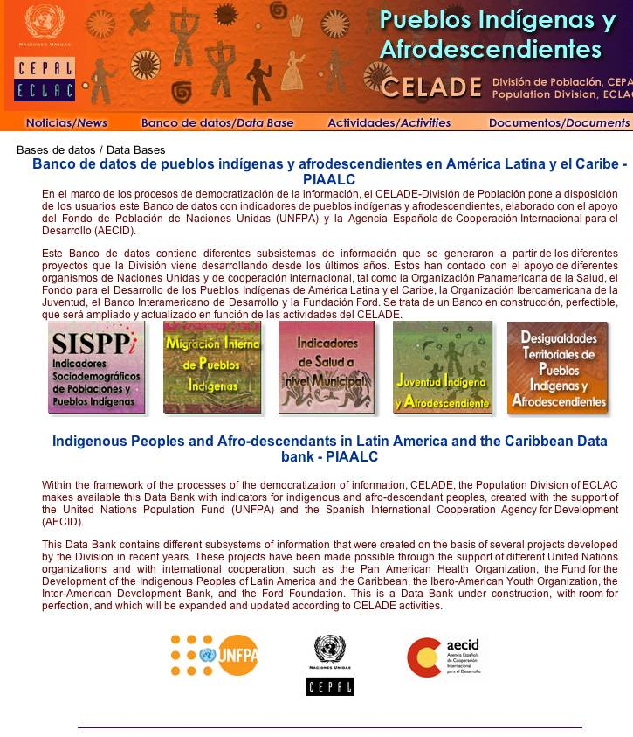
Data Bank PIAALC

Slide 19
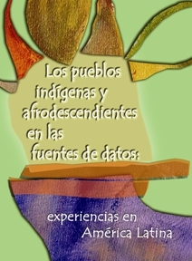
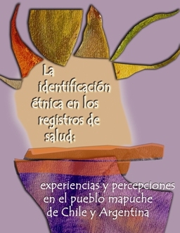
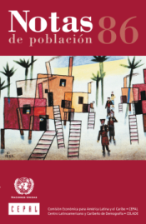

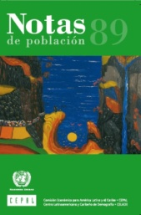
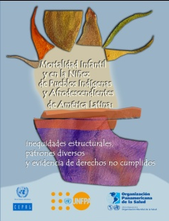

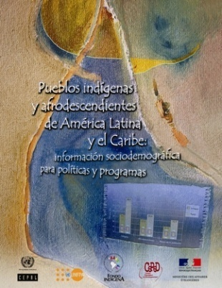
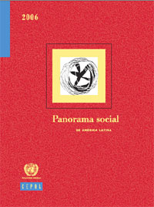
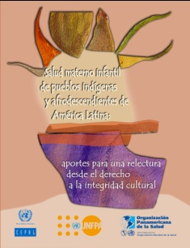

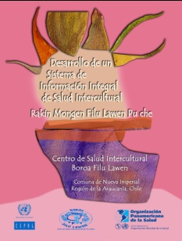
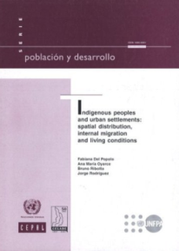
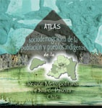
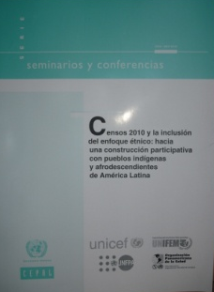
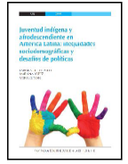
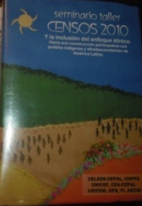
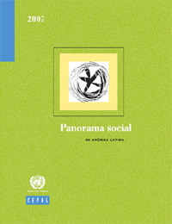
Thank you
www.cepal.org/celade/indigenas

